Slide 1

Hypothesis analysis m2
Rachit pahwa

Slide 2

Agenda
Introduction
Hypothesis made in m1
Statistical and graphical data
conclusion

Slide 3

Introduction
In M1, we made some hypothesis by their appearance for all features in the data of Creditworthiness.
Now, we are going to find out whether we were right making those hypothesis or not by statistical and graphical presentation of those features.

Slide 4

Primary goals
Making best model for the bank so it won’t give loans to non-deserving

Slide 5
Loan_ID
Correlation between Loan_ID and Loan_Status is 0.0986, which is almost zero and not giving any value to our data.
Besides, it is just a reference number given to the client and clearly not have anything to do with data. So, we’re going to remove this feature.

Slide 6
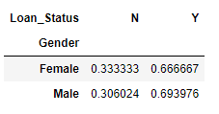
Gender
Correlation between Gender and Loan_Status is 0.021, which is almost zero and not giving any value to our data.
Hypothesis made on this feature was the same that it may not matter much in today’s world specially.
Statistical data shows almost the same percentage of getting the loan or not irrespective of Gender.

Slide 7
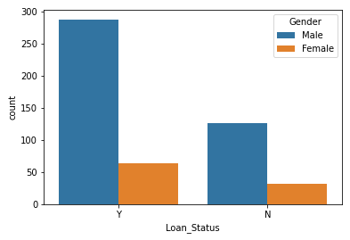
Gender
Let’s see now Graphical comparison and find out whether it gives us the same results or not.
Well, it tells that female are less in number applying for loan but getting loan or not is in the same ratio. So conclusion is that hypothesis was correct.

Slide 8
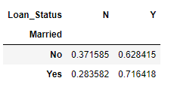
Married
Correlation between Gender and Loan_Status is 0.093, which is almost zero and not giving any value to our data.
Hypothesis made on this feature was the same that it may be important for making the model.
Statistical data shows almost the slightest percentage difference between getting the loan or not for person being married or not.
Well, it tells that female are less in number applying for loan but getting loan or not is in the same ratio.

Slide 9
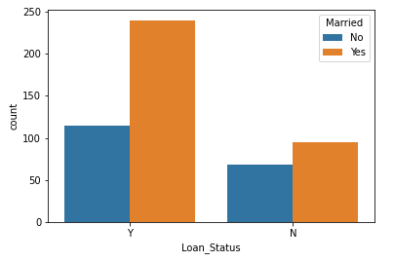
Married
Let’s see now Graphical comparison and find out whether it gives us the same results or not.
Well, it tells that when you’re getting a loan then being married is going to add a big factor behind it. So concludingly, it is an important feature. Hypothesis was right.

Slide 10

Education
Correlation between Education and Loan_Status is 0.107, which is almost zero and not giving any value to our data.
Hypothesis made on this feature was the same that it may or may not be important for making the model.
Statistical data shows significant percentage difference between getting the loan or not for person being Educated or not.
Well, it tells that female are less in number applying for loan but getting loan or not is in the same ratio.

Slide 11
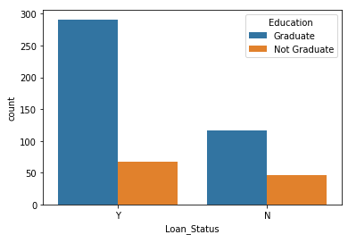
Education
Let’s see now Graphical comparison and find out whether it gives us the same results or not.
Well, it tells the same thing as statistical table. So concludingly, it is an important feature. Hypothesis was wrong.

Slide 12
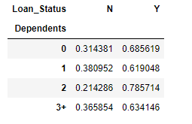
Dependents
Correlation between Education and Loan_Status is -0.02, which is almost zero and not giving any value to our data.
Hypothesis made on this feature was the same that it may be important for making the model.
Statistical data is not very clear. Let’s try with graphical presentation.
Well, it tells that female are less in number applying for loan but getting loan or not is in the same ratio.

Slide 13
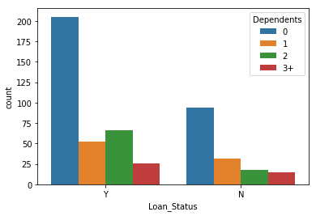
Dependents
Let’s see now Graphical comparison and find out whether it gives us the same results or not.
Well, it is clearly showing when there is no dependent then applicant is most likely to get a loan. So, it is an important feature. Hypothesis was right.

Slide 14
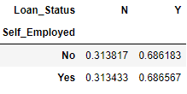
Self employed
Correlation between Self_Employed and Loan_Status is 0.001, which is almost zero and not giving any value to our data.
Hypothesis made on this feature was the same that it may be important for making the model.
Statistical data is very much clear showing almost same percentage so it seems less important feature. Let’s try with graphical presentation.
Well, it tells that female are less in number applying for loan but getting loan or not is in the same ratio.

Slide 15
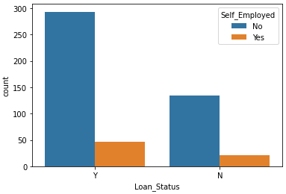
Self employed
Let’s see now Graphical comparison and find out whether it gives us the same results or not.
Well, it is clearly showing whether you’re employed or not that will have nothing to do with getting a loan. So, it is not an important feature. Hypothesis was wrong.

Slide 16
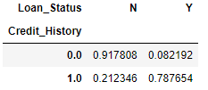
Credit history
Correlation between Credit history and Loan_Status is -0.52, which is significant and giving good value to our data.
Hypothesis made on this feature may be important for making the model.
Statistical data is very much clear showing that this is very important feature. Let’s try with graphical presentation.
Well, it tells that female are less in number applying for loan but getting loan or not is in the same ratio.

Slide 17
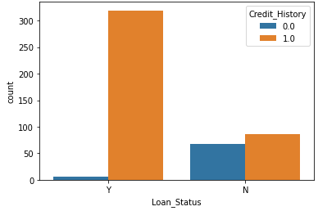
Credit history
Let’s see now Graphical comparison and find out whether it gives us the same results or not.
Well, it is clearly showing having credit history helps a lot getting a loan. So, it is an important feature. Hypothesis was right.

Slide 18
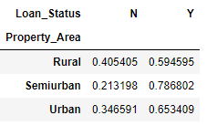
Property area
Correlation between Loan Status and Property_Area is -0.13, which is less and not giving good value to our data.
Hypothesis made on this feature may not be important for making the model.
Statistical data is showing that Semiurban applicant will have more chances. This is little important feature. Let’s try with graphical presentation.
Well, it tells that female are less in number applying for loan but getting loan or not is in the same ratio.

Slide 19
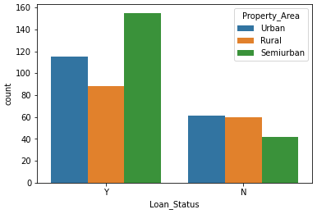
Property area
Let’s see now Graphical comparison and find out whether it gives us the same results or not.
Well, it is clearly showing having Semiurban property helps getting a loan. So, it is an important feature. Hypothesis was wrong.

Slide 20
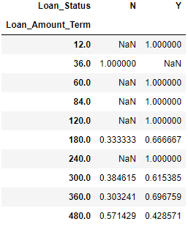
Loan amount term
Correlation between Loan Amount term and Loan Status is 0.053, which is less and not giving good value to our data.
Hypothesis made on this feature may be important for making the model.
Statistical data is not showing clear idea about the relation between these two. This is little important feature. Let’s try with graphical presentation.
Well, it tells that female are less in number applying for loan but getting loan or not is in the same ratio.

Slide 21
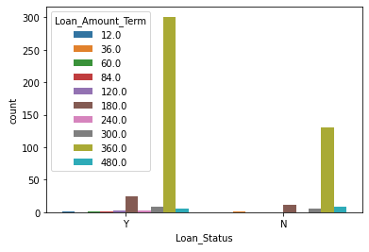
Loan amount term
Let’s see now Graphical comparison and find out whether it gives us the same results or not.
Well, it is clearly showing for 360 months duration, chances is higher of getting a loan. So, it is an important feature but again more study is required. Hypothesis was right.

Slide 22



Applicant income
Correlation between Applicant Income and Loan Status is 0.022, which is less and not giving good value to our data.
Hypothesis made on this feature may be important for making the model.
Statistical data is not showing clear idea about the relation between these two. This is not seem to be important feature. Let’s try with graphical presentation.
Well, it tells that female are less in number applying for loan but getting loan or not is in the same ratio.

Slide 23
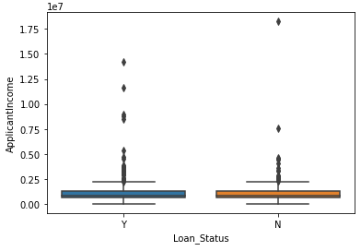
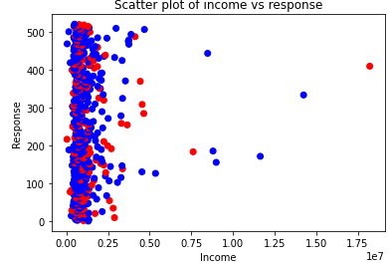
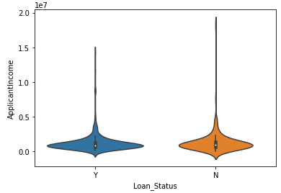
Applicant income
Let’s see now Graphical comparison and find out whether it gives us the same results or not.
Well, it is visible the same as statistical data that there is not much relation with applicant salary with getting a loan. Hypothesis was wrong.

Slide 24



coApplicant income
Correlation between Coapplicant Income and Loan Status is 0.006, which is less and not giving good value to our data.
Hypothesis made on this feature may be important for making the model.
Statistical data is not showing clear idea about the relation between these two. This is not seem to be important feature. Let’s try with graphical presentation.
Well, it tells that female are less in number applying for loan but getting loan or not is in the same ratio.

Slide 25
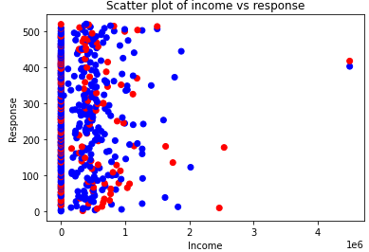
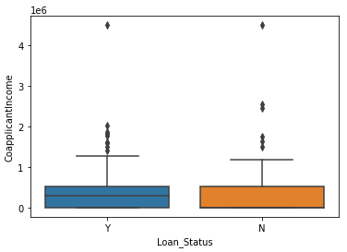
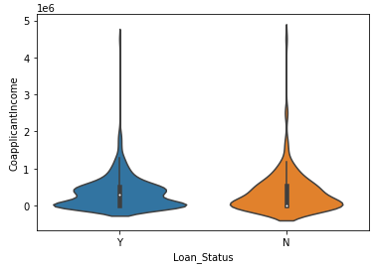
CoApplicant income
Let’s see now Graphical comparison and find out whether it gives us the same results or not.
Well, it is visible the same as statistical data that there is not much relation with co-applicant salary with getting a loan. Hypothesis was wrong.

Slide 26



Loan amount
Correlation between Loan Amount and Loan Status is 0.045, which is less and not giving good value to our data.
Hypothesis made on this feature may be important for making the model.
Statistical data is showing that for higher loan amount is usually end up not getting a loan. This seem to be important feature. Let’s try with graphical presentation.
Well, it tells that female are less in number applying for loan but getting loan or not is in the same ratio.

Slide 27
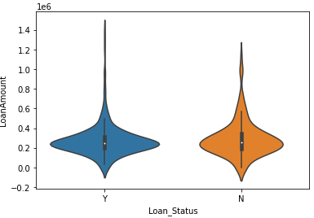
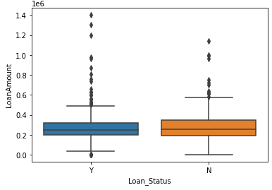
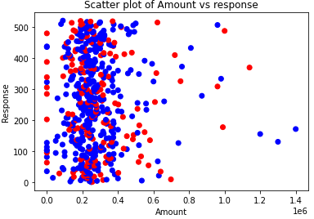
Loan amount
Let’s see now Graphical comparison and find out whether it gives us the same results or not.
Well, it is visible the same as statistical data that there is more rejection when loan amount is high. Hypothesis was right.

Slide 28


Thank you
Rachit pahwa
rachitpahwa367@gmail.com | www.linkedin.com/in/rachit-pahwa-93527b9a/

